Slide 1
Real-Time Well Log Prediction from Drilling Data Using Machine Learning
Rishabh Pandey

Slide 2
Motivation
Geophysical logs are important for subsurface resource estimation and exploitation
To record geophysical logs, wireline measurements are selectively deployed and are not available for every well
Predictive tool for rock properties from drilling parameters can help companies make an informed decision and save them thousands of dollars
Notes:
As we all know that geophysical logs are extremely important for subsurface resource estimation but at field wireline measurements are particularly deployed on well by well basis as they are expensive and sometimes are even not available for every well.
What we have is the recoded drilling data. So a tool to predict rock properties from drilling parameters can help companies make an informed decision and save them thousand of dollars

Slide 3
Objective
Predict geophysical logs namely density, neutron porosity and compressional sonic from drilling parameters
Notes:
So the objective of my work is to …

Slide 4
Data Source
Publicly available drilling and log data of Well MIP 3H of Marcellus Formation (http://www.mseel.org/)

Slide 5
Workflow
Data Pre-Processing:
Remove outliers from log and drilling data
Merge drilling and log data
Scaling drilling data using MinMax Scaler
2. Split test/train data
3. Supervised Learning: Regression
Input Labels: Depth, ROP, WOB, Rotary Torque, MSE, Flow
Predicting Labels: Neutron Porosity, Bulk Density, Compressional Sonic
Algorithms:
Random Forest Regression
KNN Regression with K Neighbors
Linear Regression
Support Vector Regression
MLP Regression

Slide 6
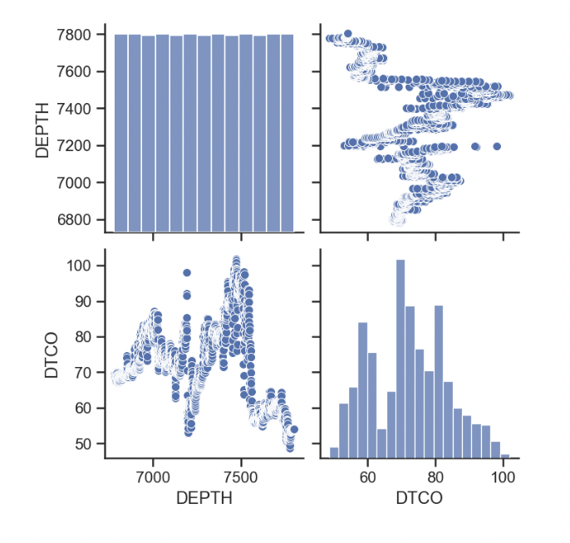
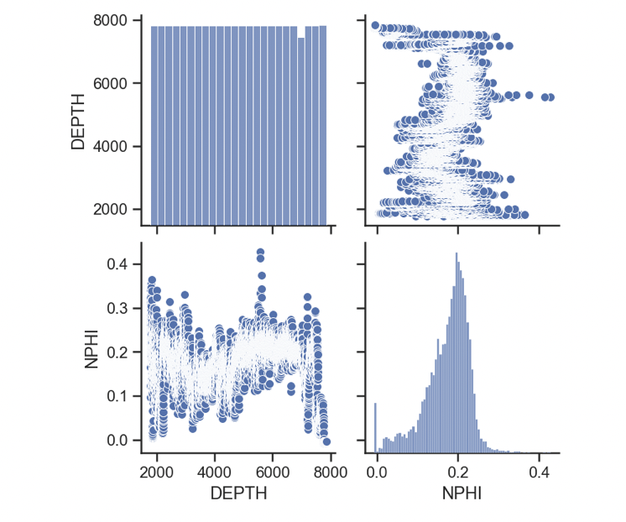
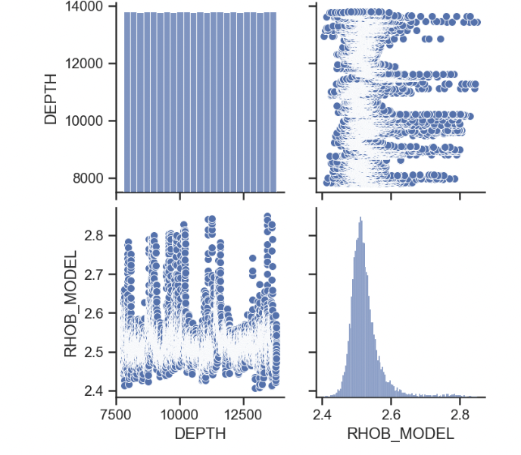
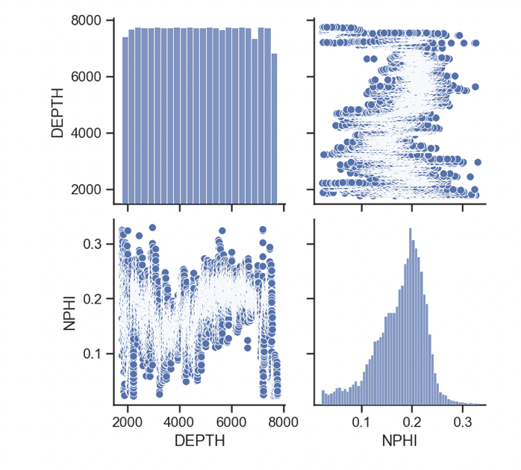
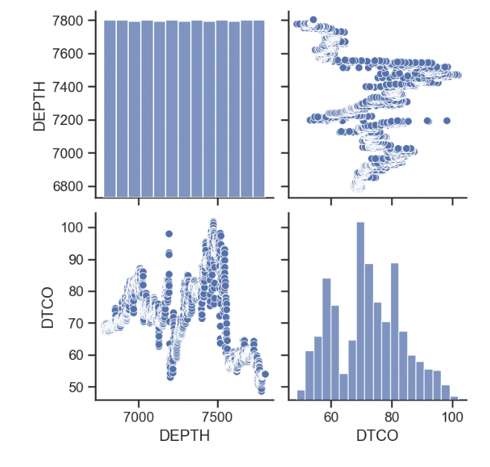
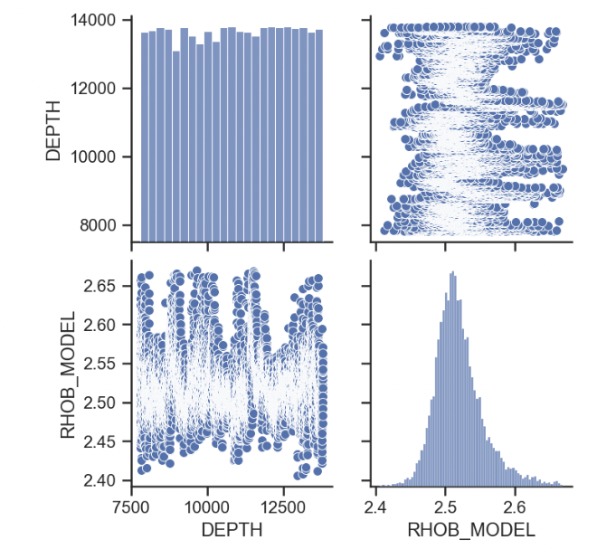
Data Pre-Processing: Log Data
Matrix scatter plot before removing outliers:
Matrix scatter plot after removing outliers:
Notes:
By analyzing the matrix scatter plots of neutron porosity and bulk density we can say outliers have been removed.

Slide 7
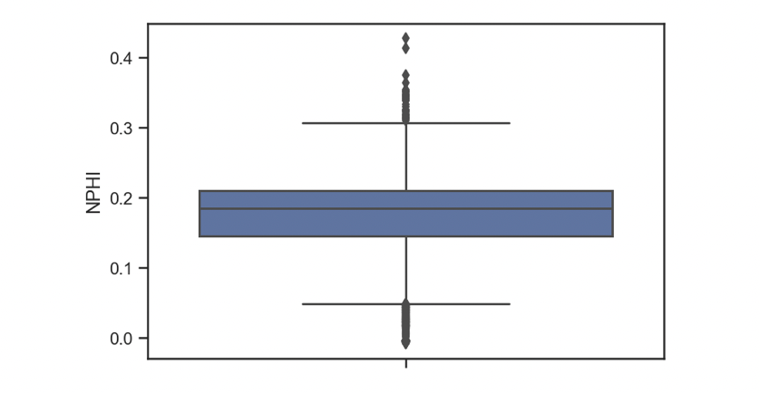
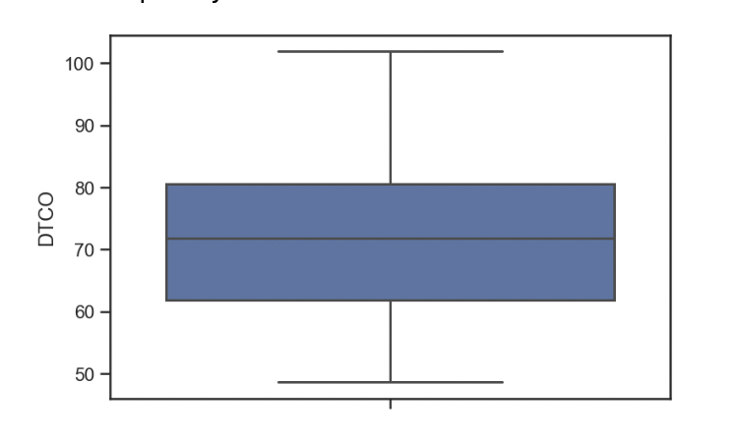
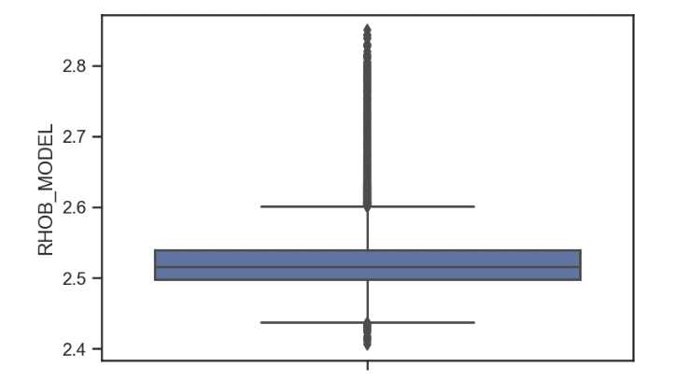
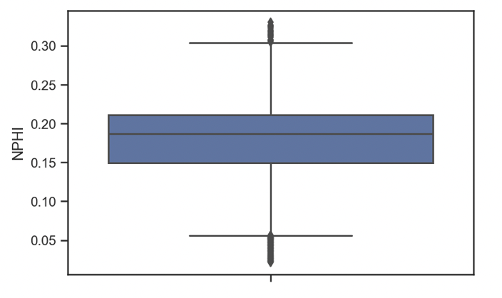
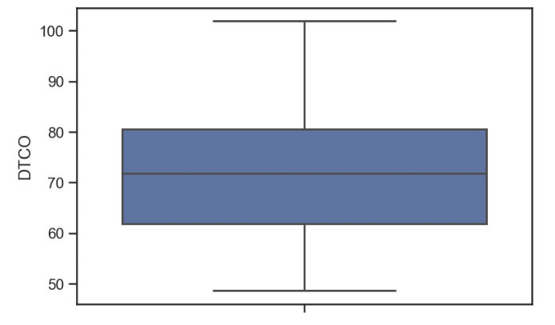
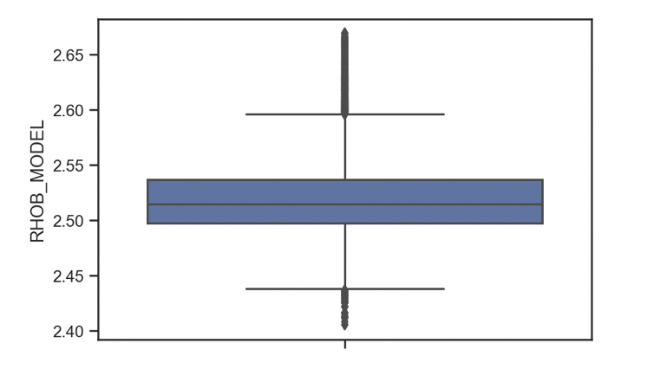
Data Pre-Processing: Log Data
Box plot before removing outliers:
Box plot after removing outliers:
Notes:
Removal of outliers can be confirmed from the box plots.

Slide 8
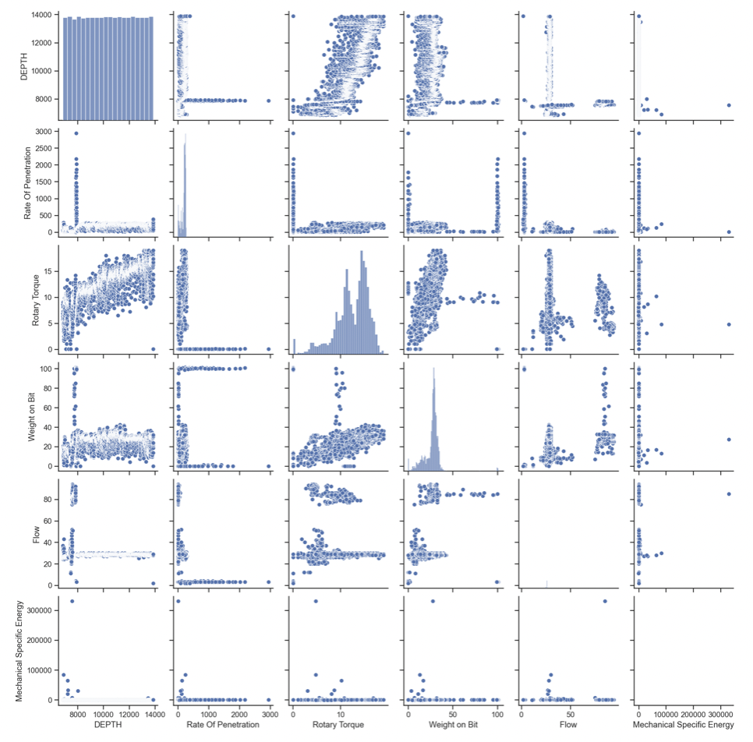
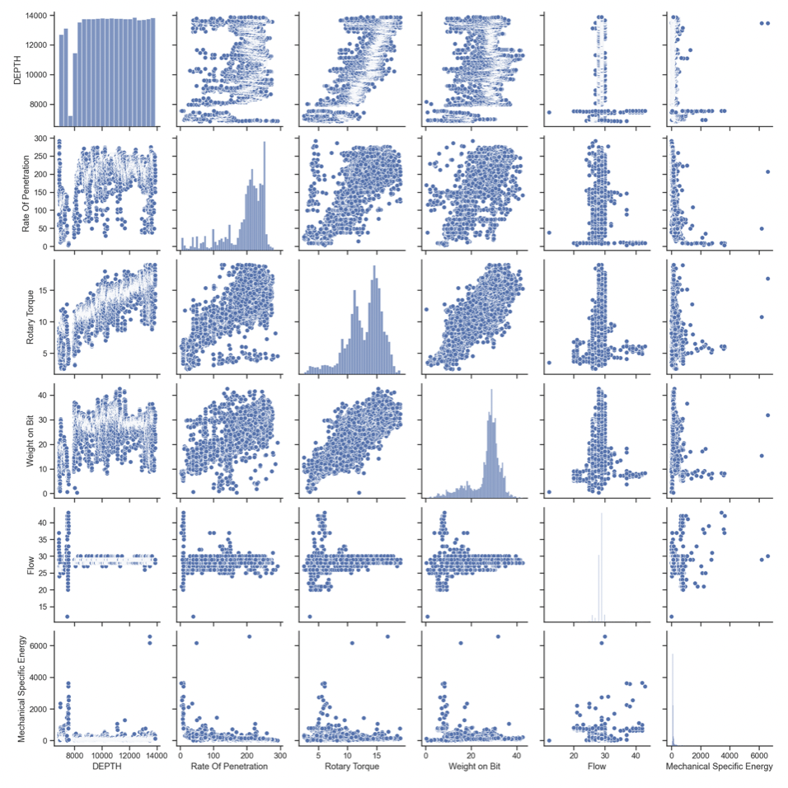
Data Pre-Processing: Drilling Data
Matrix scatter plot before removing outliers:
Matrix scatter plot after removing outliers :
Notes:
By analyzing the matrix scatter plots we can say outliers have been removed from ROP, Torque, WOB, Flow and MSE

Slide 9
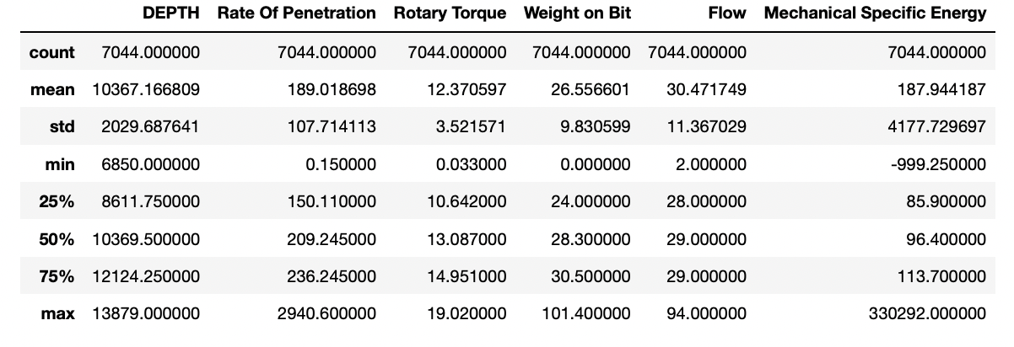
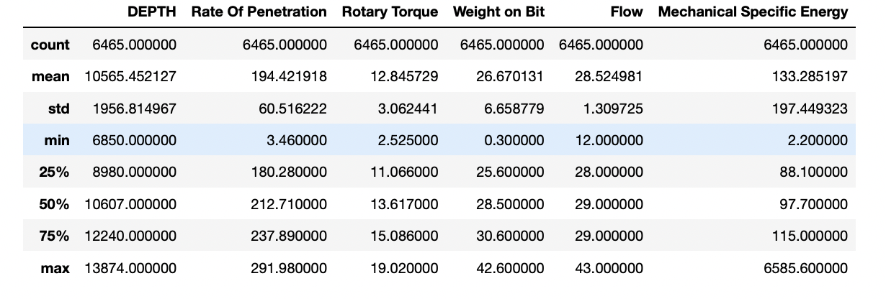
Data Pre-Processing: Drilling Data
Before removing outliers:
After removing outliers:
Notes:
By analyzing here we can say negative MSE, zero ROP, Zero WOB have been removed

Slide 10
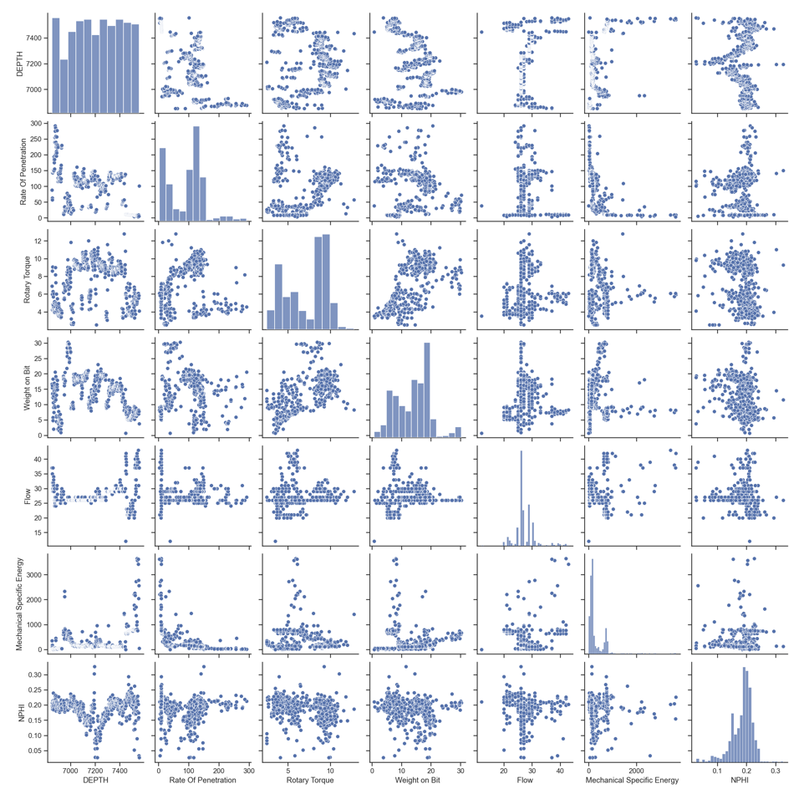
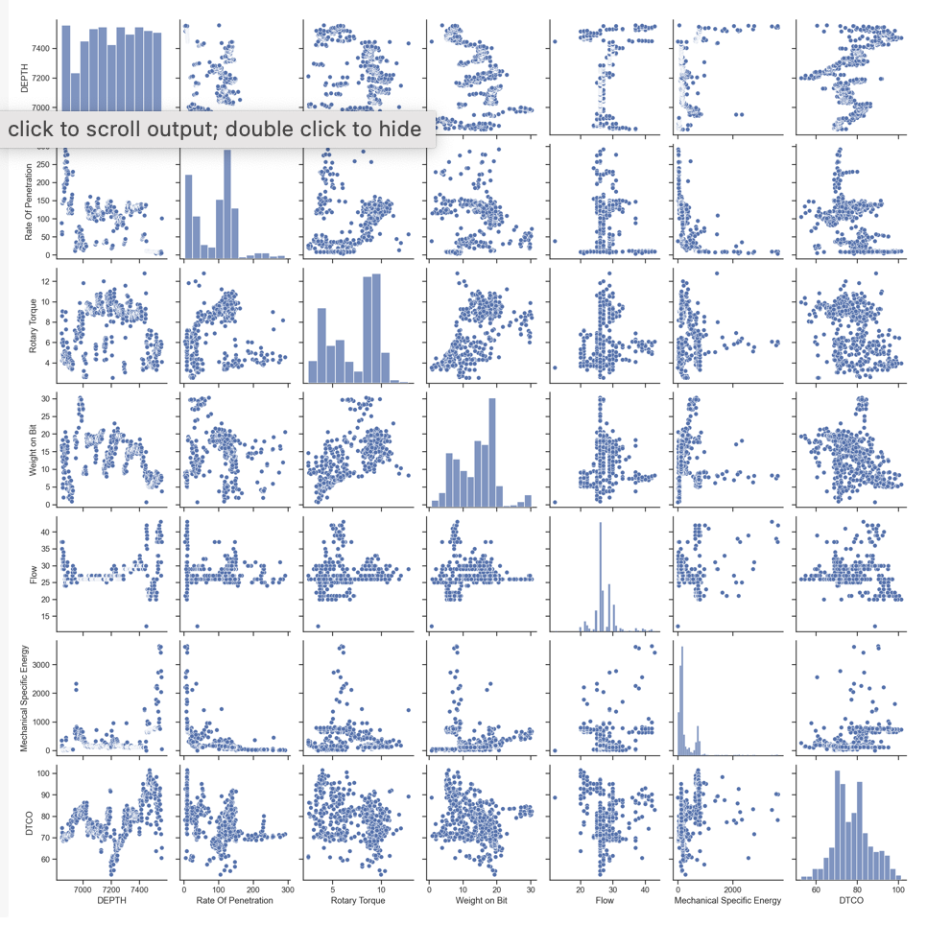
Data Pre-Processing: Merge Drilling and Log Data
Matrix scatter plot of Drilling and NPHI:
Matrix scatter plot of Drilling and DTCO:
Notes:
Depth in drilling data had a difference of 1 ft while depth in log data had a difference 0.5 ft. So I did merge both drilling ang log data by keeping depth common which made the data continuous.
Scatter plots here shows the relationship between drilling data, bulk density, compressional sonic and neutron porosity.

Slide 11
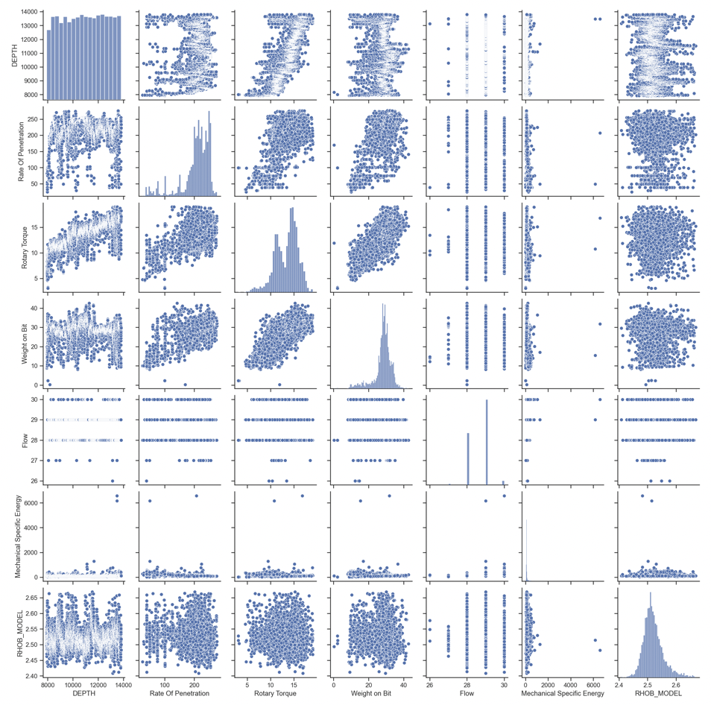
Data Pre-Processing: Merge Drilling and Log Data
Matrix scatter plot of Drilling and RHOB:

Slide 12
Data Pre-Processing: Scaling
Scale the data using MinMax Scaler
Input drilling data i.e. depth, ROP, WOB, rotary torque, MSE and flow are scaled keeping output log data i.e. bulk density, neutron porosity and compressional sonic separate

Slide 13
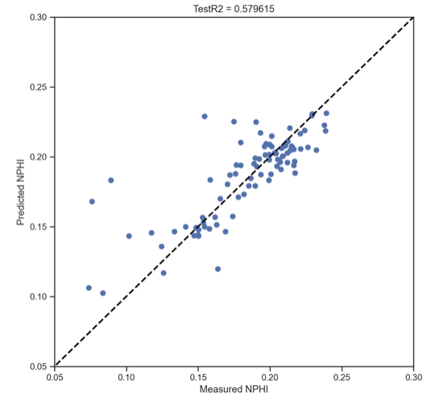
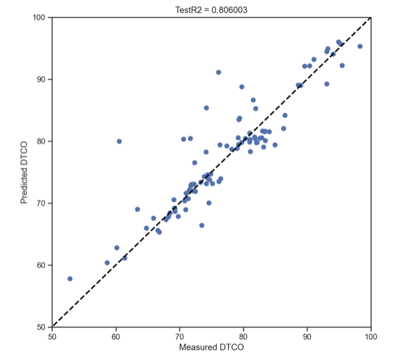
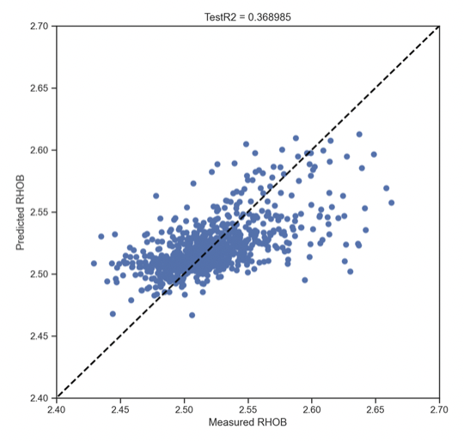
Random Forest Regression
Test size: 15 %
RMSE: 0.02748
RMSE: 3.9831
RMSE: 0.0281
NPHI
DTCO
RHOB

Slide 14
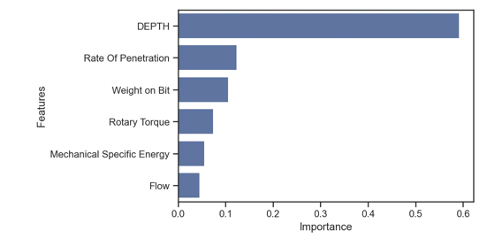
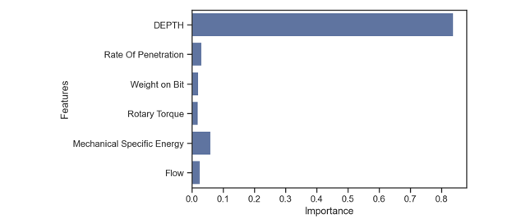
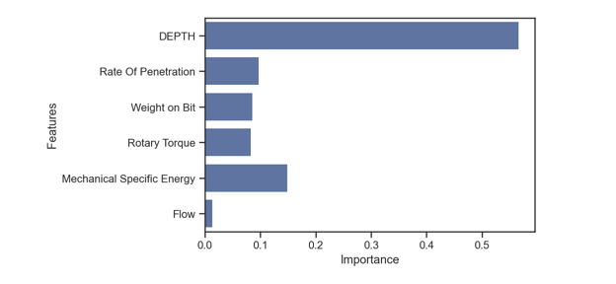
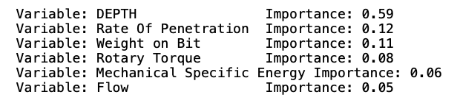
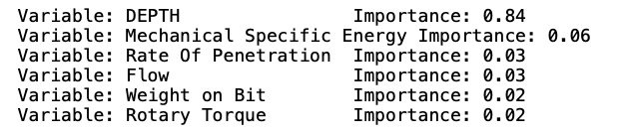
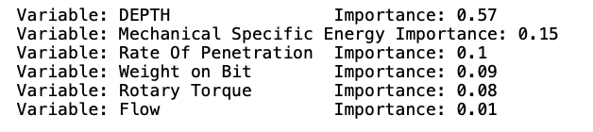
Variable Importance
NPHI
DTCO
RHOB

Slide 15
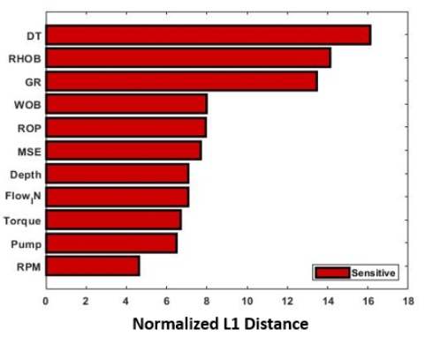
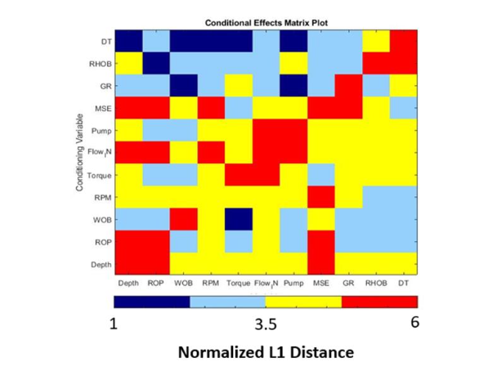
Variable Importance
Ryan Kanfar(2020)
Input Data | Output Data
Depth, ROP, WOB, Rotary Torque, MSE | NPHI
Depth, ROP, WOB, Rotary Torque, MSE | RHOB
ROP, WOB, Rotary Torque, MSE | DTCO

Slide 16
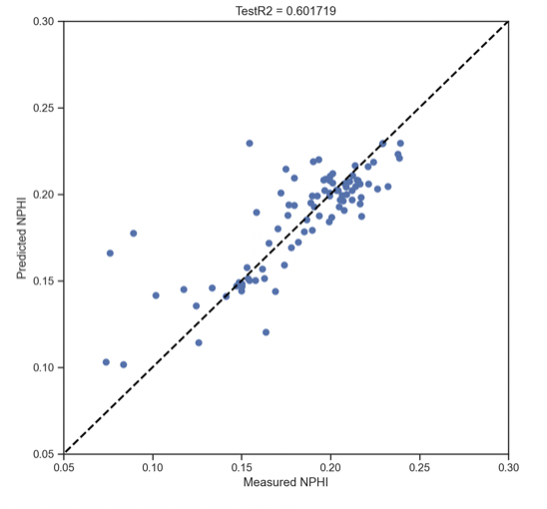
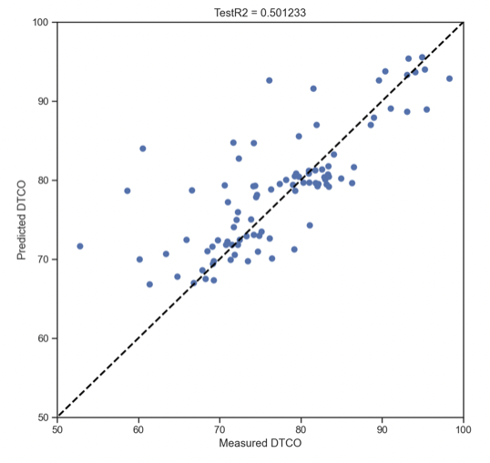
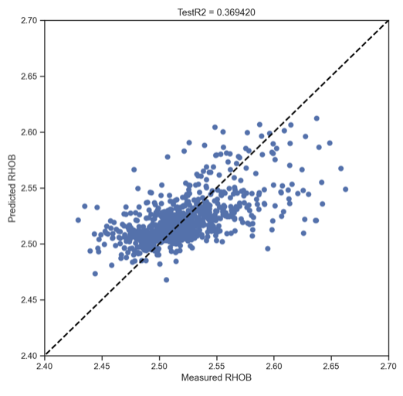
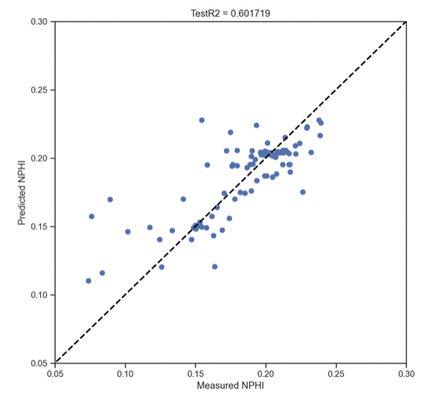
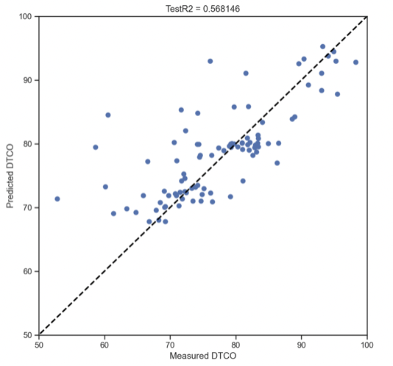
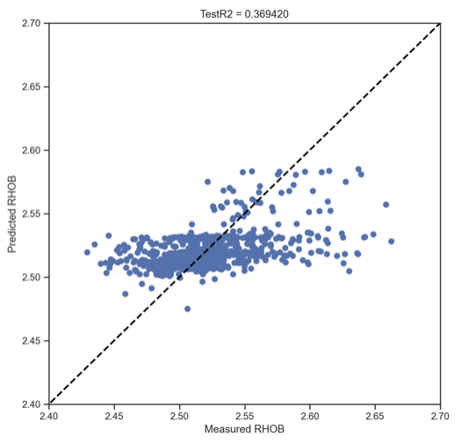
Random Forest Regression and Hyperparameter Optimization
NPHI
DTCO
RHOB
RMSE: 0.02675
RMSE: 5.9429
RMSE: 0.02809
Hyperparameter Optimization for RF , Number of Folds: 10
RMSE: 0.0275
RMSE: 6.1790
RMSE: 0.0311

Slide 17
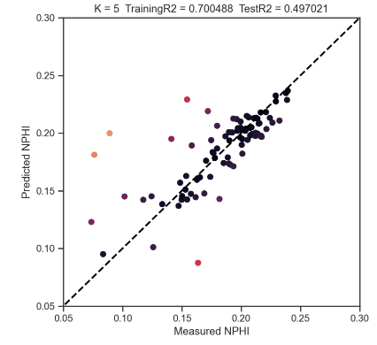
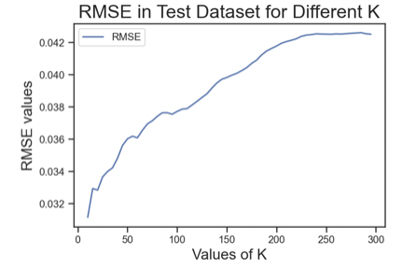
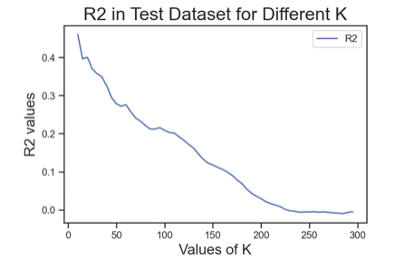
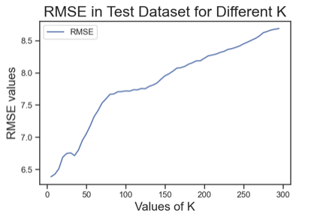
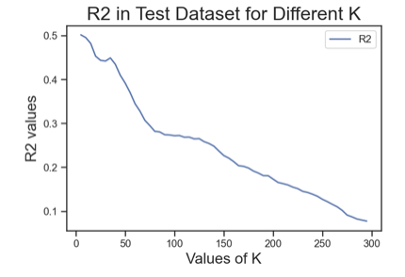
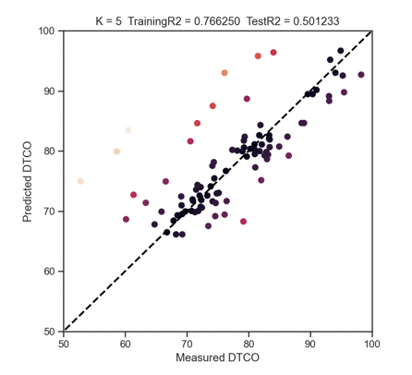
KNN Regression with K Neighbors
NPHI
RMSE: 0.000904
DTCO
RMSE: 6.386

Slide 18
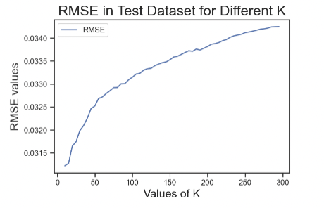
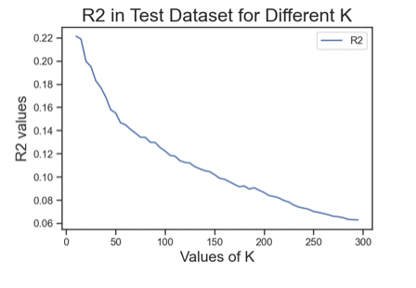
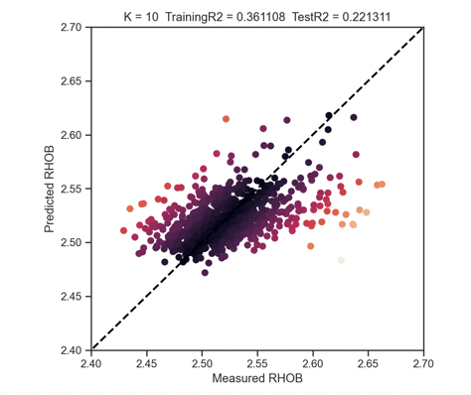
KNN Regression with K Neighbors
RHOB
RMSE: 0.000974

Slide 19
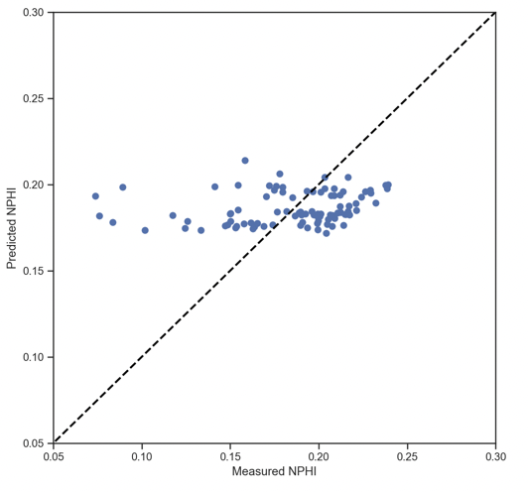
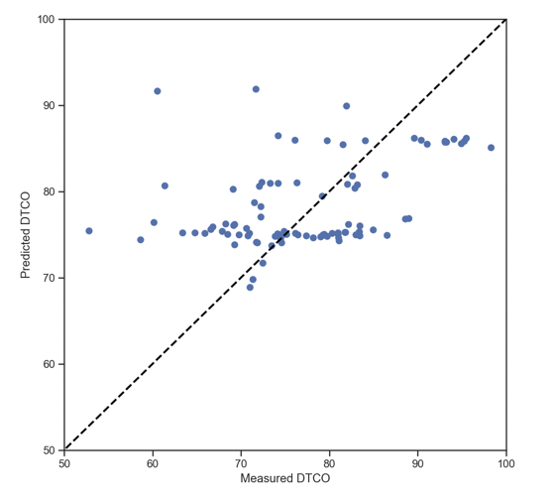
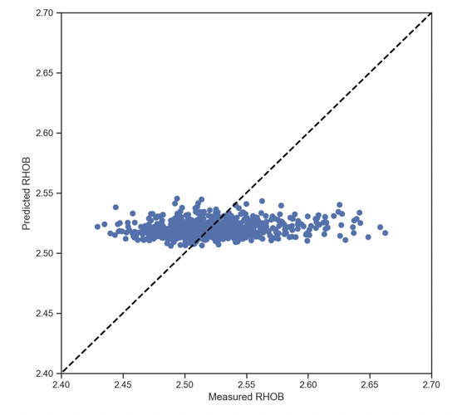
Linear Regression
NPHI
DTCO
RHOB
RMSE: 0.0426
RMSE: 8.397
RMSE: 0.001217

Slide 20
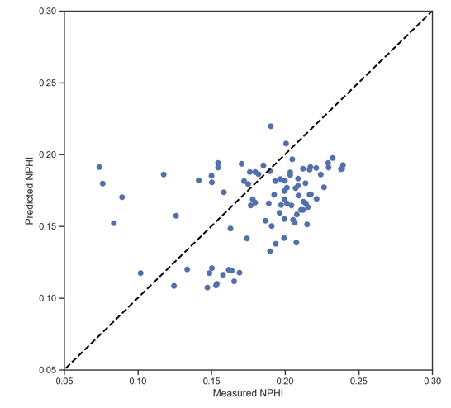
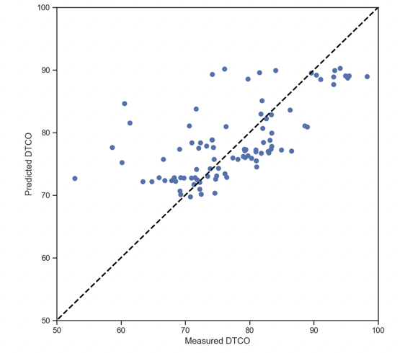

Support Vector Regression
NPHI
DTCO
RHOB
RMSE: 0.0019
RMSE: 6.9741
RMSE: 0.0018

Slide 21



Hyperparameter Optimization for SVR
NPHI
DTCO
RHOB
RMSE: 0.00097
RMSE: 6.0383
RMSE: 0.0426

Slide 22



MLP Regression
NPHI
DTCO
RHOB
RMSE: 0.04335
RMSE: 7.9725
RMSE: 0.00159

Slide 23



Hyperparameter Optimization for MLP Regression
NPHI
DTCO
RHOB
RMSE: 0.00096
RMSE: 6.2546
RMSE: 0.00121

Slide 24
Conclusions

Slide 25
Conclusions

Slide 26
Conclusions
By Analyzing the Accuracy and RMSE values:
1. Neutron Porosity:
Observation: RF has the least RMSE and maximum Accuracy.
Conclusion: RF is the best method to predict Neutron Porosity from drilling data
2. Compressional Sonic:
Observation: RF, KNN, SVR and MLP have similar RMSE and Accuracy
Conclusion: Either of RF, KNN, SVR and MLP can be used to predict Compressional Sonic from drilling data
3. Bulk Density:
Observation: RF, KNN, SVR have similar RMSE and Accuracy
Conclusion: Either of RF, KNN, SVR can be used to predict Compressional Sonic from drilling data
By Analysing the RMSE values:
RMSE values of Neutron Porosity and Bulk Density are less than 0.05 which means the regression models for Neutron Porosity and Bulk Density are a great fit and observed data points are close to the model’s predicted values

